Slide 1
Histograms and Box Plots
RX 319
Introduction to Healthcare Analytics

Slide 2
Learning Objectives
Interpret a histogram.
Interpret a box plot.
Identify ggplot2 commands to make histograms and box plots.
Contrast histograms and box plots.
2

Slide 3
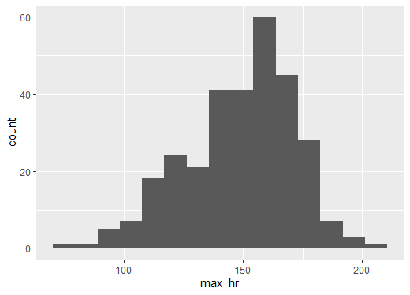
Understanding a distribution using a histogram
A histogram is a special type of bar chart.
We use it to count the number of observations of a numeric variable within certain ranges.
Age | Maximum HR | … | Heart Disease?
41 | 172 | … | Healthy
62 | 160 |  | Disease
57 | 163 |  | Healthy
56 | 153 |  | Healthy
48 | 139 |  | Healthy
58 | 162 |  | Healthy
50 | 158 |  | Healthy
58 | 172 |  | Healthy
66 | 114 |  | Healthy
69 | 151 |  | Healthy
65 | 114 |  | Disease
71 | 162 |  | Healthy
61 | 169 |  | Disease
Hundreds more…
3

Slide 4
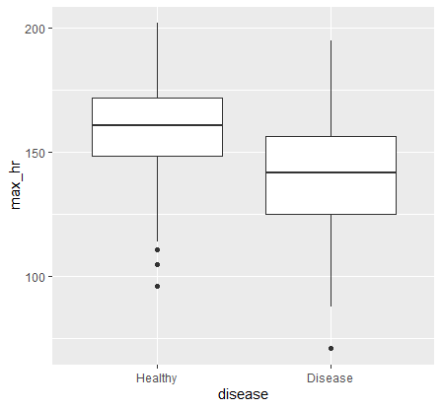
Comparing distributions with box plots
Age | Maximum HR | … | Heart Disease?
41 | 172 | … | Healthy
62 | 160 |  | Disease
57 | 163 |  | Healthy
56 | 153 |  | Healthy
48 | 139 |  | Healthy
58 | 162 |  | Healthy
50 | 158 |  | Healthy
58 | 172 |  | Healthy
66 | 114 |  | Healthy
69 | 151 |  | Healthy
65 | 114 |  | Disease
71 | 162 |  | Healthy
61 | 169 |  | Disease
65 | 157 |  | Healthy
41 | 168 |  | Healthy
51 | 142 |  | Disease
Hundreds more…
4

Slide 5
Summary
We use histograms to summarize the distribution of one numeric variable.
We use box plots to compare the distribution of a numeric variable between two or more groups.
5

